Slide 1
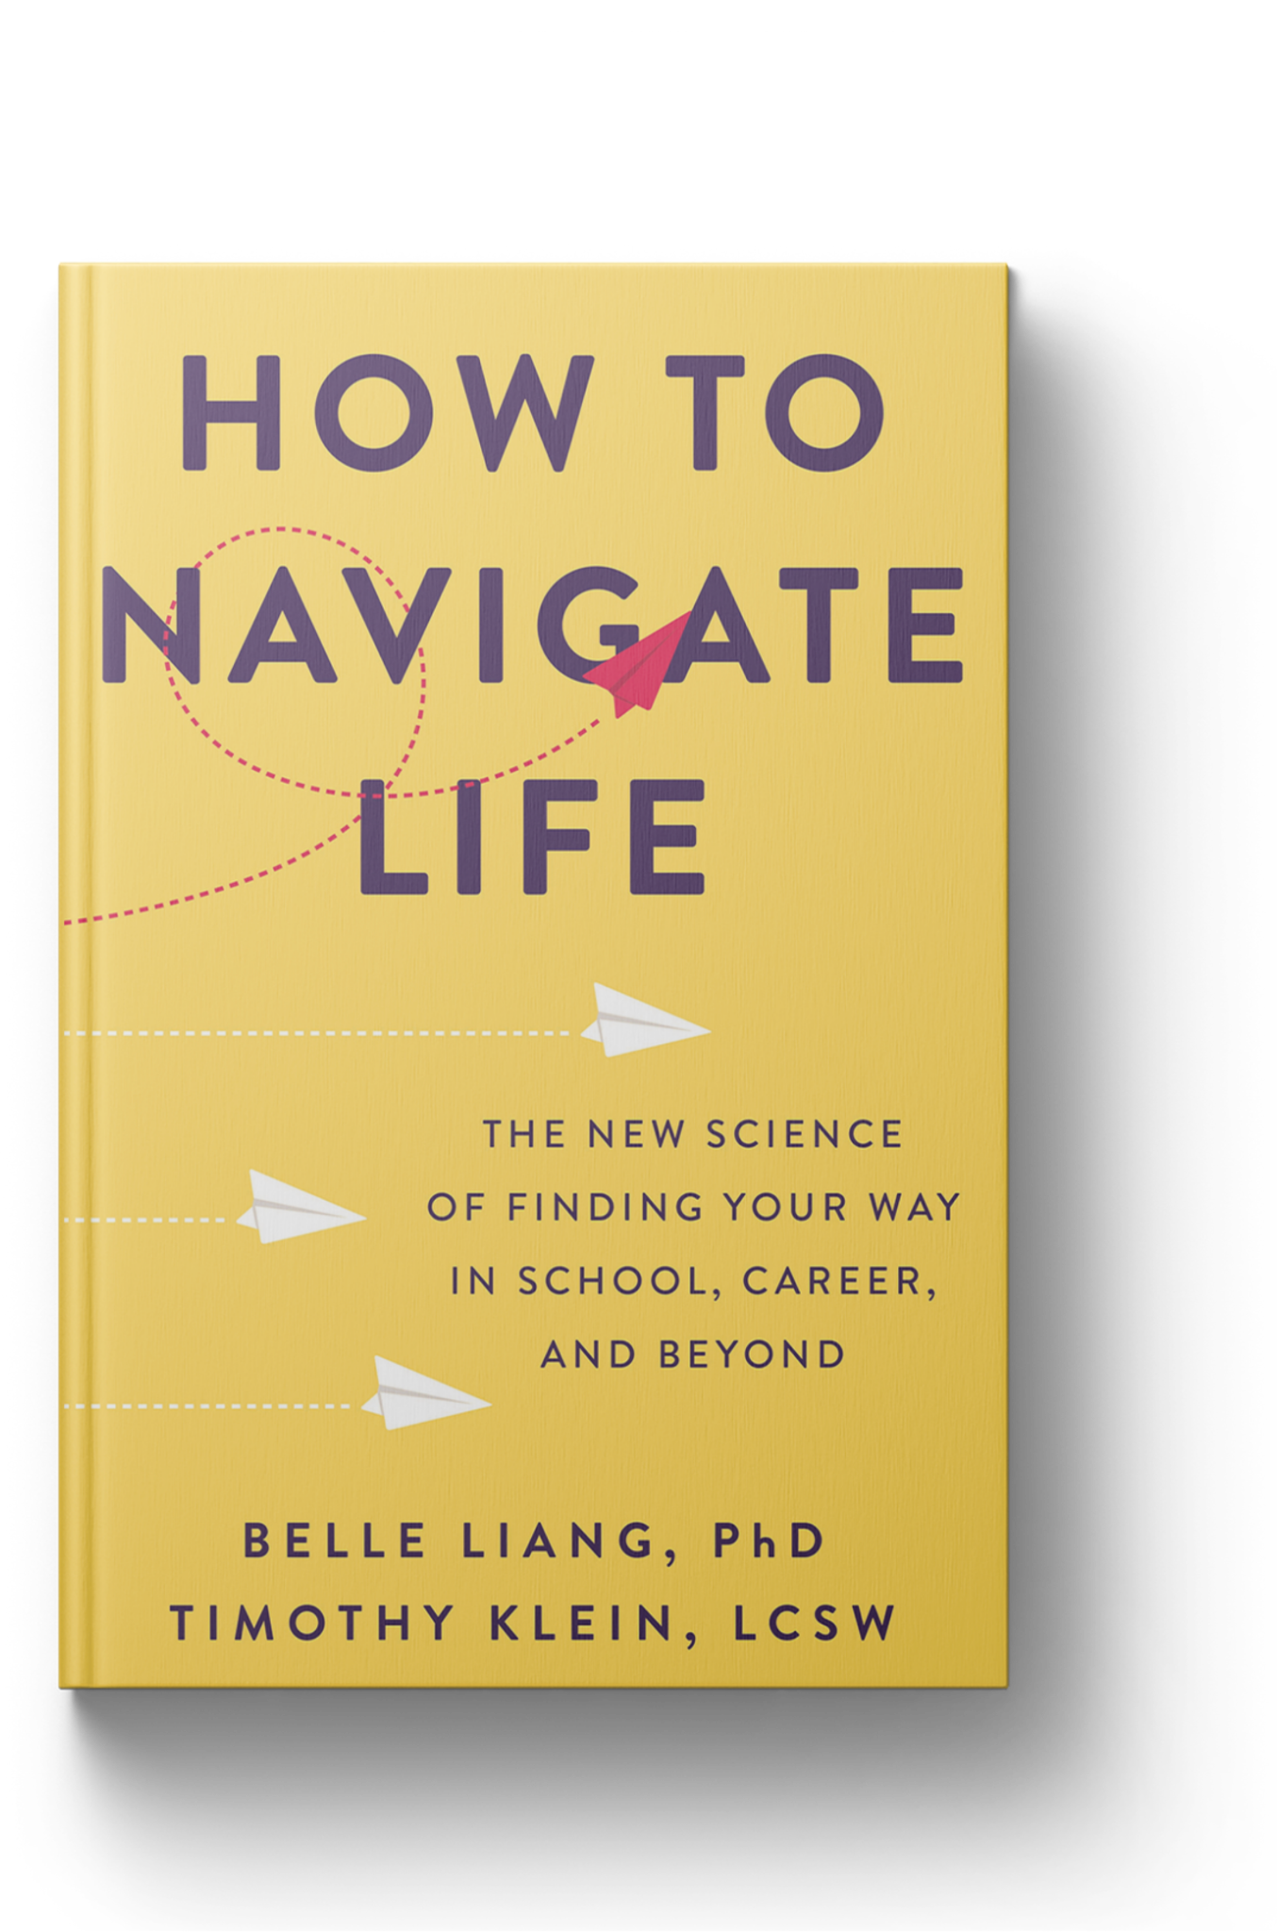
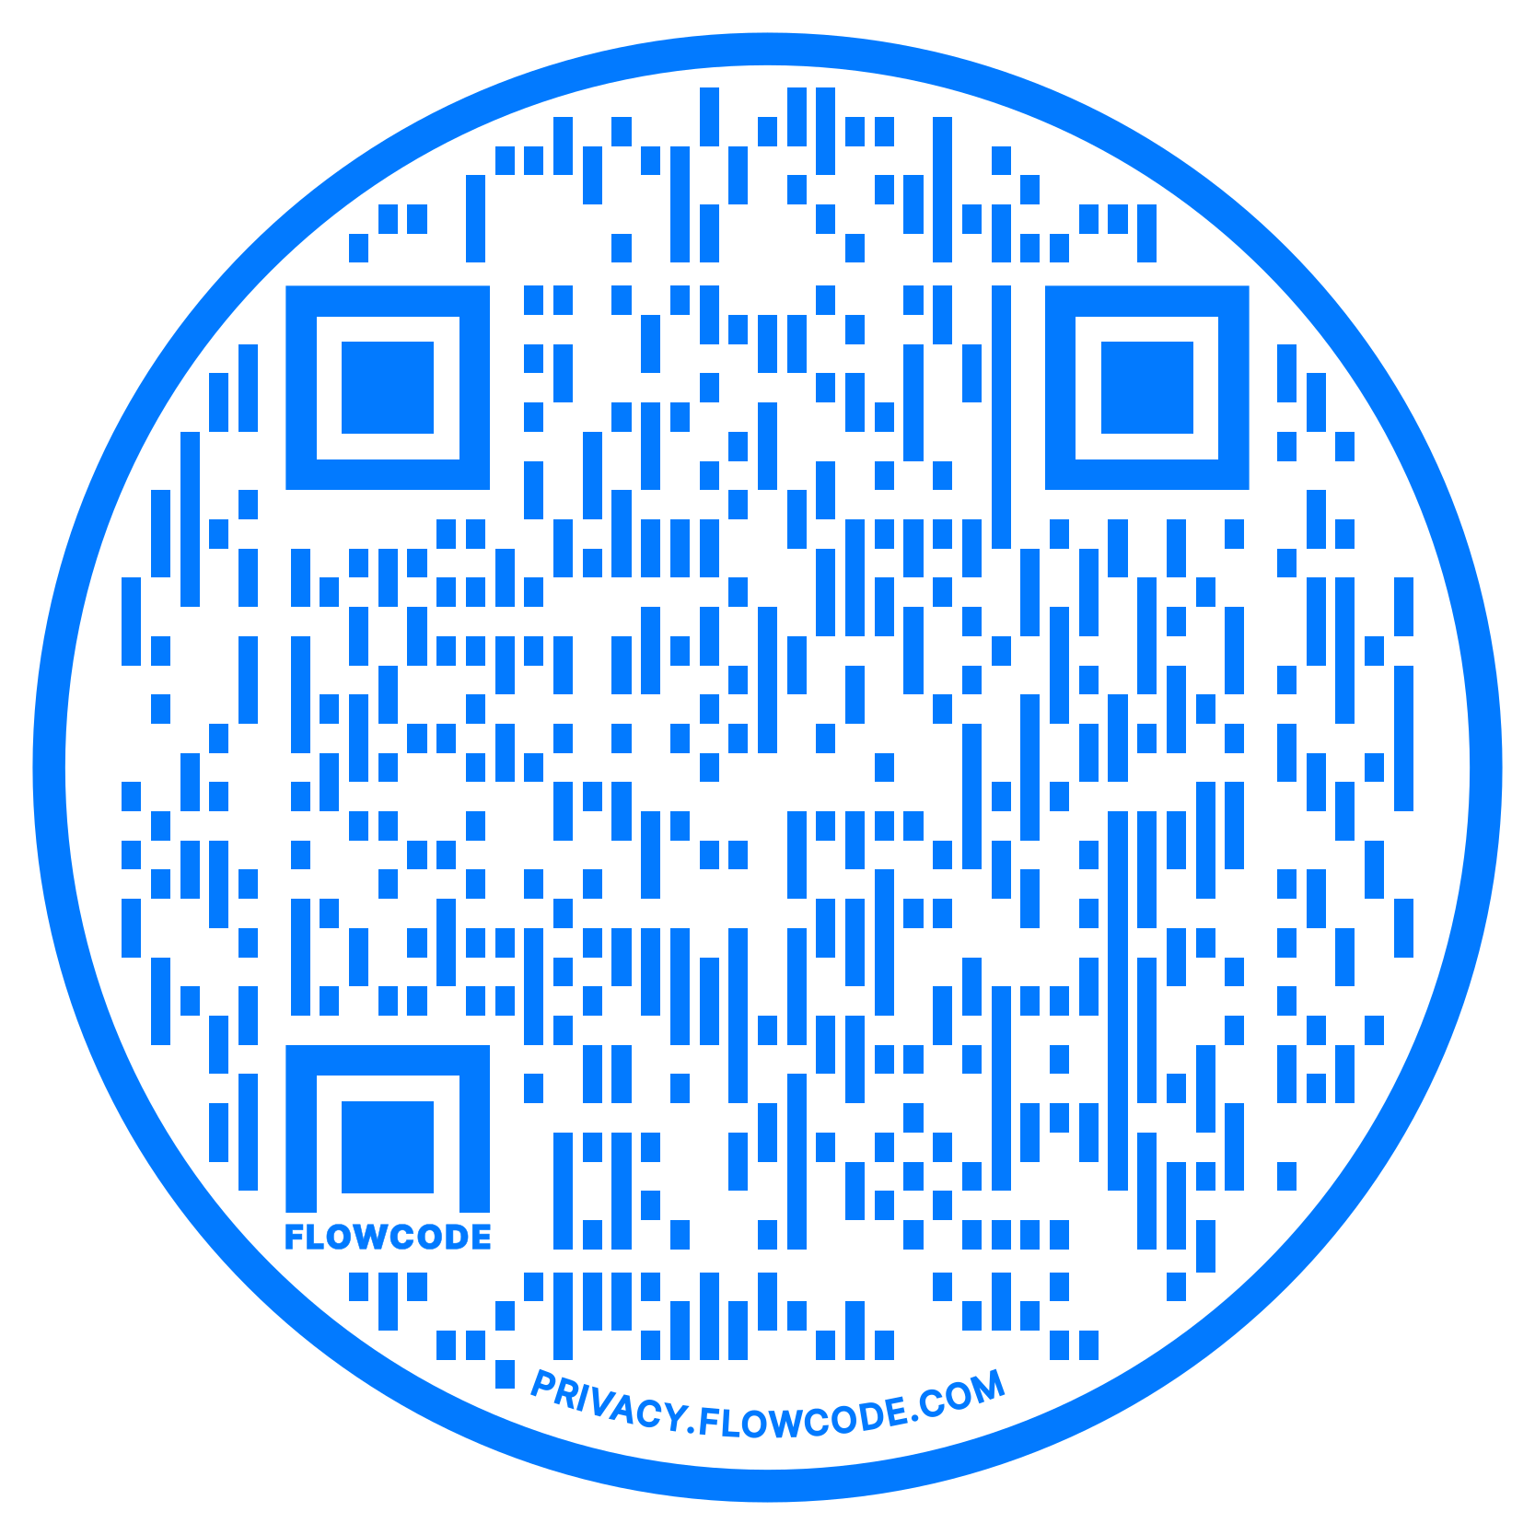
Notes:
BELLE
We’re excited and honored to be with you who are doing such important work in the field of education. Belle has been a professor Boston College in the LSEHD and Tim has been a high school guidance counselor and is now teaching at BC–where we’ve joined forces to help students navigate their way through a college and career crisis. Culminated in our book…
In particular, we specialize in helping people navigate through inflection points in their lives.
Education as a whole is at an inflection point.
We’ve had the opportunity to talk with scores of students, parents, educators, and organizational leaders from all over the country and the world, and it’s clear from hundreds of research interviews and surveys that we’ve come to a critical point in history.

Slide 2
Education is at an inflection point.
Notes:
TIM
Inflection points are seminal moments in time where the decisions and actions we make can change the trajectory of our lives.
Every inflection point comes with challenges and opportunities. Today we want to share with you the challenges we are facing as well sa the unique opportunities these challenges present. Finally we want to present some evidence based practices and strategies you can use right now to rise to these challenges.
How do we know we are at an inflection point?

Slide 3
Everyone is struggling.
Notes:
BELLE
Because everyone is struggling.

Slide 4
Young People Are Struggling
80% experienced mental health deterioration during the pandemic.
75% feel that the future is “frightening.”
56% feel that humanity is “doomed.”
50% are not actively engaged in school.
Notes:
BELLE
80% experienced mental health deterioration during the pandemic.
75% feel that the future is “frightening.”
56% feel that humanity is “doomed.”
50% are not actively engaged in school.
https://www.thelancet.com/journals/lanplh/article/PIIS2542-5196(21)00278-3/fulltext
16-25 years old (GEN-Zers)

Slide 5
Parents are struggling
75% say they needed more emotional support than they received during the pandemic.
68% believe kids will be worse off than their parents.
51% of mothers can’t give their all at work due to parenting responsibilities.
1 in 4 have been diagnosed with a mental health disorder since the pandemic.
Notes:
BELLE
75% say they needed more emotional support than they received during the pandemic.
68% believe kids will be worse off than their parents.
51% of mothers can’t give their all at work due to parenting responsibilities.
1 in 4 have been diagnosed with a mental health disorder since the pandemic.
Mothers who have increased time spent caring for children disproportionately report increased stress, anxiety, and frustrations with their children
https://scholar.google.com/citations?view_op=view_citation&hl=en&user=YVaYBo0AAAAJ&cstart=20&pagesize=80&sortby=pubdate&citation_for_view=YVaYBo0AAAAJ:ULOm3_A8WrAC
75% of parents say they needed more emotional support than they received during the pandemic.
1 in 4 parents have been diagnosed with a mental health disorder since the start of the pandemic.
https://www.apa.org/news/press/releases/stress/2021/sia-pandemic-report.pdf

Slide 6
Educators are struggling
61% say their job is always stressful which compromises their health, sleep, quality of life, and teaching.
58% report work-induced mental health problems.
54% are considering quitting within 2 years.
Notes:
BELLE
61% say their job is always stressful which compromises their health, sleep, quality of life, and teaching.
58% report work-induced mental health problems.
54% are considering quitting within 2 years.
https://www.rwjf.org/en/library/research/2016/07/teacher-stress-and-health.html

Slide 7
Everyone is burned out.
But no one knows what it means.
Notes:
TIM
Why is everyone struggling because everyone is burned out. That probably comes as no surprise because burnout has come to dominate the cultural conversation around school and work.

Slide 8
So what is burnout?
Notes:
TIM
For as much as we talk about burnout, most people don’t know what burnout actually is.
So let’s take some time right now to explore this question:
What is burnout?

Slide 9
Three signs you are burned out.
Exhaustion (you’re constantly drained of energy).
Cynicism/depersonalization (you see your clients/students as problems rather than people you can help).
Ineffectiveness (you feel your work doesn’t accomplish anything).
Notes:
TIM
Researchers have been studying the concept of burnout since the late 1970’s and have identified 3 universal symptoms of burnout. (As an aside you have to score highly on all three of these subscales to be burned out.) Don’t know if what we’re about to share will make you all feel better or worse, but Cristina Maslach’s research shows that human-service professionals are acutely sensitive to burnout.
But these are just the symptoms of burnout … what actually are the root causes of burnout?

Slide 10
What causes burnout?
Notes:
TIM
What is burnout caused by?

Slide 11
“Burnout is being pulled between expectation & reality.”
Notes:
BELLE
The actual definition of burnout is being pulled between expectation and reality. Burnout happens when there is a gap between these We’re all simultaneously living in 2 worlds, the world in our mind which informs how we think things should be, and the actual reality of the world around us.

Slide 12
Expectations
What we want/predict will happen.
Burnout
Reality
What actually does happen.
Notes:
BELLE
The greater the gap between these two worlds, the GREATER the burnout.
In other words, the greater the gap between what you EXPECT to feel, do & achieve at work and the REALITY of your life– the GREATER the burnout.
The constant battle of dealing with this gap emotionally and tangibly in our work drains us. We feel disillusioned, exhausted, ineffective. Burnout is being drained by this gap. It drains us physically (exhaustion and poor health), mentally (disempowerment) and spiritually (cynicism).
Have you heard this definition of burnout?
That’s not your fault…it’s because the cultural conversation about burnout misses the point.

Slide 13
The cultural conversation about burnout misses the point.
Notes:
TIM
We only talk about the symptoms but not the root cause of burnout.

Slide 14
Feeling exhausted?
Practice self-care. Put yourself first. Focus on your passion.
Notes:
TIM
When you’re feeling exhausted, the general advice is to practice self-care. You hear people say: put yourself self first, focus on what makes you passionate.

Slide 15
Feeling ineffective?
Grind more. Hustle harder. Focus on your performance.
Notes:
TIM
When you’re feeling ineffective, the general advice is to work harder. Be more productive, focus on performance.

Slide 16
Have you heard this advice?
Does it feel helpful, actionable, & realistic?
Notes:
BELLE
Raise your hand if you’ve heard this advice?
How’s it working for you?
Does it feel helpful and realistic to put ourselves first when we have super demanding jobs and needs at home?
We can grind more but it doesn’t usually help us feel more effective at work.

Slide 17

Notes:
BELLE
One of the big reasons these solutions miss the point is because they address the symptoms of burnout but not the causes.
This is like looking up at this building seeing the billows of smoke and thinking that we just need a huge fan to blow it away. Nevermind that that there’s a literal fire burning down the building. We know that the smoke is but a symptom of the real problem, the fire we cannot see burning everything up.
Second problem is that the cultural conversation focuses on changing our reality without addressing our expectations. And the reality isn’t easily changed without changing our expectations first.

Slide 18
Why is there a gap between our expectations and reality?
Notes:
BELLE

Slide 19
Mindset
What we believe to be true about ourselves and the world.
Success
What’s worthy and valuable in the world.
Reality
What actually happens in the world.
Expectations
What we want/predict will happen in the world.
Notes:
TIM
Our sense of reality is driven by our expectations which in turn are driven by our definitions of success, which in turn are driven by our mindset.
We start with reality and that’s the world we experience. But reality is influenced by our expectations. Our expectations are influenced by how we define success. And our definitions of success are influenced by our mindsets (what we believe about ourselves and our world).
One of the big drivers to a gap between expectations and reality is that we’re walking around with a life framework/mindset that falls short of reality. In other words, how do you view life? What are your expectations of how it works?
In our research there are 2 mindsets that fall short. The first is the performance mindset.

Slide 20

The Performance Mindset
Mindset
The goal of life is to win.
Success
Defined by how you compare to other people.
Expectations
Acquire the most (status, prestige, power wealth.)
Reality
Never have enough.
Notes:
TIM
Mindset: Posits that the goal of life is to win. Life is a hyper-competitive zero-sum game with few winners and many losers.
This mindset is driven from the fear of not having enough (money, jobs, resources, opportunities)
Ultimately, your self-worth is measured by how you compare to other people.
Success: is defined by external metrics (salaries, titles, accolades, etc). How you compare to others.
Expectations: Acquire the most. For example, the expectation that if they get into the best colleges they will be all set–successful and fulfilled. Stories and examples. Think about gifted and talented students? If their gifted in athletics, they feel that they need to get into an ACC college. If they are gifted in academics, they need to get into an Ivy League university.
Reality: It makes us hustle but we never feel enough…so if your definition of success is external metrics…there is always someone better than you. That drives feelings of insignificance.

Slide 21
The Passion Mindset
Mindset
The goal of life is to be happy.
Success
Defined by how feel on a daily basis.
Expectations
Maximize positive emotions and minimize negative emotions.
Reality
Never feel good enough.
Notes:
TIM
Perhaps you don’t subscribe to the performance mindset, you realize there is more to life than passion mindset. On the other side of the spectrum is the passion mindset.
MINDSET: Posits that the goal of life is to to be happy. Y
SUCCESS: you achieve this by only doing what you want to do and doing what you love.Success is defined by how you feel.
EXPECTATIONS: Success becomes about maximizing all positive emotions while minimizing or avoiding any negative emotions.
REALITY: The reality is that when life is about maximizing positive emotions, we never feel good enough.
It’s part of the humaan condition to feel the whiole spectrum of human emotions, the good the bad, the ugly. The passion mindset subscribes to the dangerous notion that some emotions are to be avoided. You all are educators–your most noble goals cause stress, anxiety, and even anger. What would happen if we gave up on our goals as educators just to avoid these negative emotions.
There is no such thing as glass half full when you have a performance or passion mindset. These two mindsets are all or nothing propositions if you are buying into a performance mindset. You need to be the best…and if you aren’t you feel like you are failing.
If you are buying into the passion mindset, you want to be happy all the time, and if you aren’t you feel like you are failing.
So if the glass is not filled to the brim with achievements or positive emotions, it might as well be empty.

Slide 22
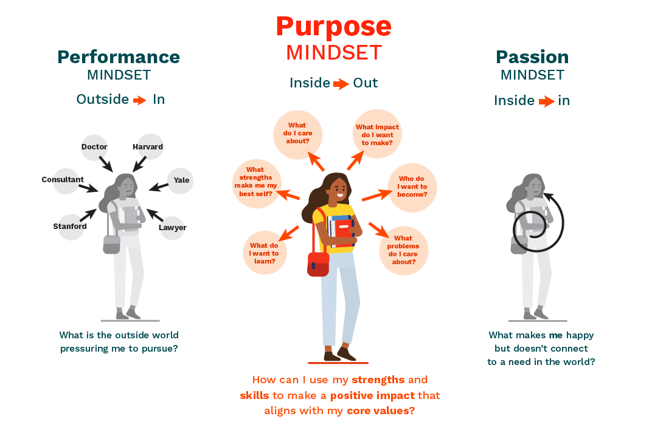
Notes:
BELLE
Here’s a visual of the performance and passion mindsets...you can see that this person is bogged down by outside expectations. Trying to live up to extrinsic metrics of success. These expectations fall short of reality because they don’t bring the fulfillment we expect. Once you get there, you wonder what else there is. Examples: you don’t have to look far to see tht from our students to Olympic gold medalists like Michael Phelps.
People on the other end of the spectrum aren’t thinking of the outside world, they’re overemphasizing their own happiness...and these people also feel the gap between expectations and reality. they think this will make them feel fulfilled and successful, but happiness is linked with happenings…which are constantly changing like the weather in Texas. Once the circumstance that is making you happy passes, you’re back to feeling unhappy.
The person with the purpose mindset has a balance...they’re first thinking about what is personally meaningful to them and then their thinking about how they can connect what’s personally meaningful to them with tackling some real need in the world.
—-
The contrast is finding an enduring purpose. Helping your gifted and talented students to find a purpose that is enduring. Which means a purpose where life mission and your whole journey around that mission involves something that’s personally meaningful in the long run and that’s bigger than yourself.

Slide 23

The Purpose Mindset
Mindset
The goal of life is to contribute in a meaningful way
Success
Defined by how fulfilled and connected you feel.
Expectations
Use our strengths + skills to make an impact that aligns with our core values.
Reality
We know what enough is.
Notes:
BELLE
Mindset: the goal of life is to contribute in a meaningful way.
Success: is defined by how fulfilled and connected you feel.
Expectations: use your strengths + skills to make an impact that aligns with your core values
Reality: we know what enough is.
Purposeful people are still working hard but purpose gives them the energy they need to keep going in the face of challenges. Purposeful people still have negative emotion and stress but they’re more resilient in the face of it because they have energy in the tank, and their not being drained because they know what enough is. Example of son and guitar wanting to play freebird.

Slide 24
Ultimately, performance/passion mindsets are born from a feeling of “not enough”.
So let’s talk about what “enough” actually means.
Notes:
BELLE
Performance & passion mindsets focus our energy on answering one central question. Am I enough? – successful enough, happy enough?
But without a clear definition of what’s enough, we look outside ourselves to answer that question. We compare our success/happiness to those around us. (why kids look at instagram and go from happy to unhappy in 15 seconds)
So no matter how much we hustle or grind we aren’t successful enough. No matter how many emotional highs we hit, it’s never enough. We kill ourselves pouring ourselves into a cup that never fills.
So let’s talk about enough actually means.

Slide 25
Let’s find your enough.
Notes:
BELLE
Let’s find your enough when it comes to purpose.

Slide 26
“An enduring aspiration
that’s personally meaningful &
contributes to the world beyond the self.”
Notes:
TIM
Purpose is an enduring aspiration that’s personally meaningful and contributes the world beyond yourself.
In other words, It’s a purpose that matters to you for more than a second. It lasts and is bigger than yourself.

Slide 27
What’s personally meaningful to you?
Notes:
TIM
Diving deeper… how do you figure out what’s personally meaningful to you?

Slide 28
Purpose Sparks
Joy
Lightens us up so we can play.
Hope
Helps us believe that things can and will change for the better.
Inspiration
Enables us to draw energy from what’s good in the world, and to add to it.
Gratitude
Gives us a sense of the blessings in our lives
Pride
Makes us conscious of our worth and dignity so we can do what matters.
Awe
Gives us the sense we are part of something much larger than ourselves.
Serenity
Calms us so we can savor the present moment.
Interest
Tunes us into something in the world so we can learn with curiosity and fascination
Amusement
Opens our eyes to the humor in things so we can take ourselves less seriously and enjoy the ride.
Love
Allows us to share all of these sparks with others, both individuals and communities.
Notes:
TIM
These are purpose sparks - when we’re experiencing them they’re clues into what’s important or personally meaningful to us. In psychology they are referred to as specific-action tendencies Read through this list.
These positive emotions have a physiological impact on our bodies that change the way we think and operate. Positive emotions increase the scope of our visuospatial attention; allowing us to literally see more of the world. They allow us to access more parts of our brain and memory allowing us to understand more of the world. Positive emotions reduce our inhibitions, fostering courage and opening us to new experiences. They flush our bodies with oxytocin, improving our ability to connect with others. Positive emotions make us more likely to trust other people, which in turn makes them trust us. This is associated with forming stronger, longer-lasting bonds with people, as well as stronger support networks. And yes, they also make us feel better: Increases in daily positive emotions improve sleep quality and bolster our immune system.
If you had to choose three of these sparks, which ones would you want to experience in your work? Which feel most important or would make your work feel most personally meaningful?
Choose three.
When you have chosen your three, go a step further: why are these sparks so important to you?
Now, brainstorm the activities that have elicited these sparks for you. What parts of your job trigger these sparks? If it were up to you and you could design your role, what activities or tasks would provide these sparks? Write them down.

Slide 29
Enough doesn’t take much.
Study of 556+ physicians: time spent on personally meaningful work activities correlated w/ burnout rates, and in turn, intentions to leave professions.
Compared to doctors who spent at least 20% of their work week on personally meaningful activities, those who spent less were 2X as likely to experience burnout.
Notes:
BELLE
Study of 556+ physicians: time spent on personally meaningful work activities correlated w/ burnout rates, and in turn, intentions to leave professions.
Compared to doctors who spent at least 20% of their work week on personally meaningful activities, those who spent less were 2X as likely to experience burnout.
The doctors who were less likely to burn out were doing meaningful work just 20% or more of the time. They weren’t necessarily needing to do meaningful work all the time to experience these positive results. Most people don’t and can’t feel these positive emotions/passion all the time. We don’t. But how can you do activities that feel meaningful once a week.
https://jamanetwork.com/journals/jamainternalmedicine/fullarticle/415000

Slide 30
“An enduring aspiration
that’s personally meaningful
& contributes beyond the self.”
Notes:
BELLE
Let’s tackle the next part of the definition of purpose and ask what contribution do you want to make?

Slide 31
What impact do you want to make?
Notes:
BELLE
What impact do you want to make?
How do you figure this out?

Slide 32
I’ll know I have succeeded when they …
can/are ready to… (skill development)
understand/learn… (content knowledge)
feel… (emotional impact)
believe… (psychological impact)
Notes:
TIM
To zero in on what impact you want to make, ask.
You know you’ve succeeded when you see what outcome of your work?
What do you hope every student/educator takes away from your work with them?
How will your students/educators benefit once they have worked with you?
Fill in the blank: I know I have succeeded when students/educators I work with....
can/is ready to… (skill development)
understands/learns… (content knowledge)
feels… (emotional impact)
believes… (psychological impact)

Slide 33
Finding Purpose: Our Cup Runneth Over
A study of 6000 lawyers found that those with a purpose mindset (enjoying the work + thinking it’s important) had less depression and greater wellbeing.
These positive outcomes were associated with working more hrs.
The more these lawyers worked, the more fulfilled and better off they were.
Notes:
TIM
The purpose mindset makes us more passionate about our work and it improves performance.

Slide 34
How to fill your purpose cup:
Make sure people have the right cup.
Share your cup with other people.
Fill others’ cups
Pour selectively.
Notes:
TIM
Make sure people have the right cup: to do this you need to make sure that people have the right expectations and mindsets
Share your cup: share with students, colleagues what your purpose is. Education can be isolating so create moments to share with your people.
Fill others cups: affirm and recognize others purpose
Pour selectively: we can’t do everything…
What filter do you use to decide where & when to pour? A purpose mindset.
The irony is that when you commit to a purpose mindset, the by product is we end up gaining those rewards we so desperately seek with the other mindsets. Improved mental health, improved productivity, etc.
Tons of research showing that these are the outcomes.

Slide 35
Thank you!
Reach out at tim@howtonavigate.com
Learn more at: howtonavigate.com
Notes:
BELLE
Q & A and get more information here…

Slide 36
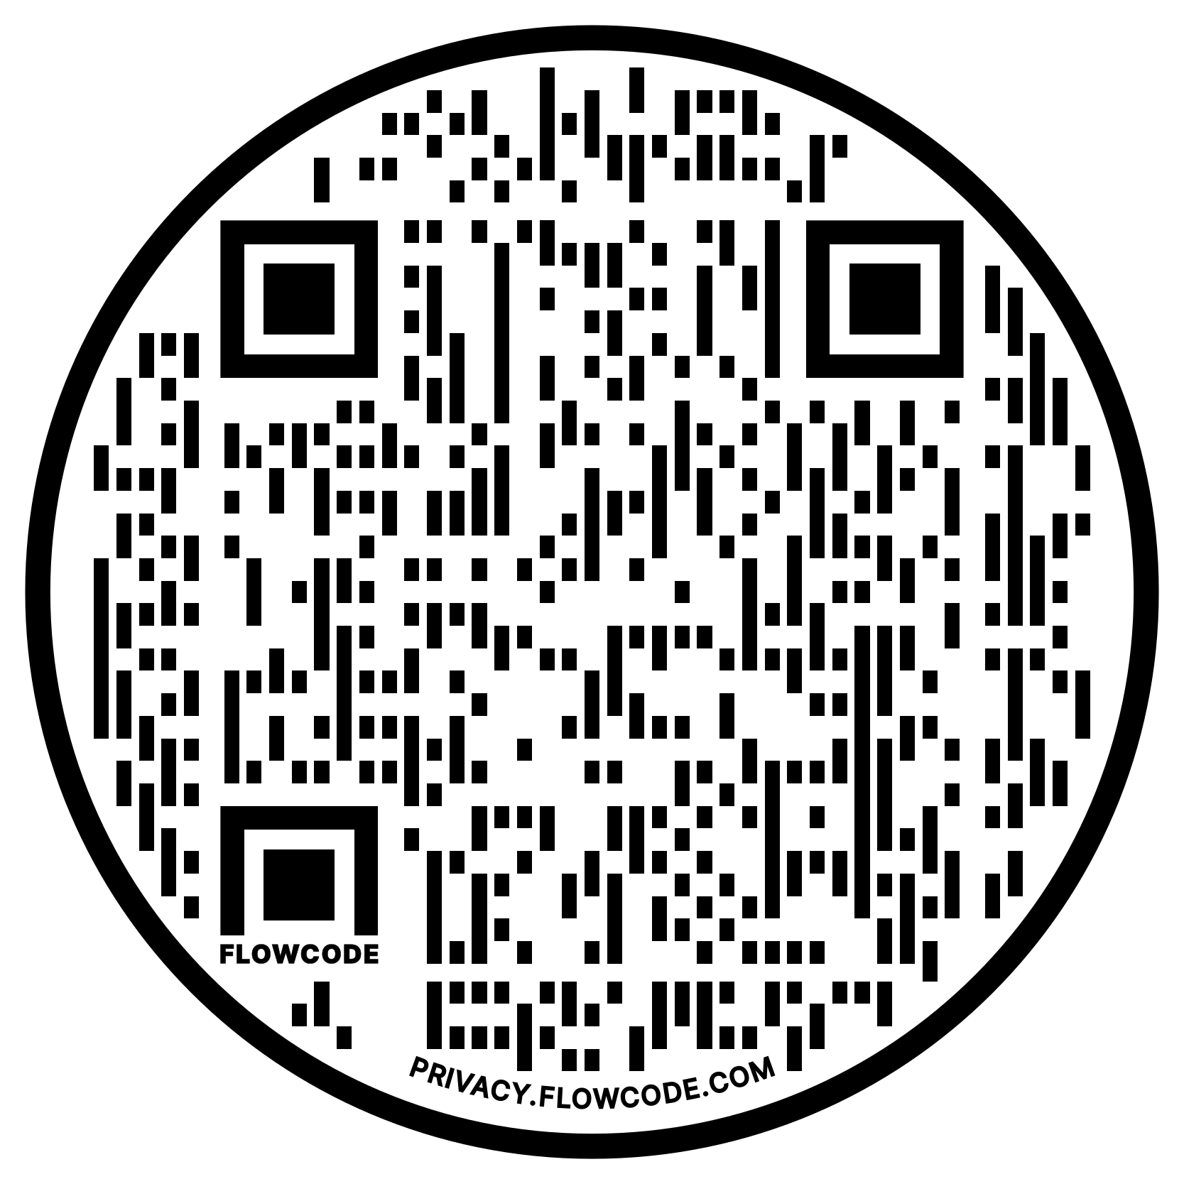
Take Our Values Quiz at tinyurl.com/TAGTValues
Notes:
BELLE
One final gift for you. Our purpose lab has been developing these assessments to help you identify your elements of purpose. This one is values archetypes. Each of us has a set of values that guide our work approach. Your results will be completely anonymous.

Slide 37
How PBI Education Works
The shared language of purpose fosters a sense of purposeful belonging at each stage of the education journey.
PBI connects the dots between a student’s, educator’s and communities’ sense of purpose.
Organizational Purpose
Organizational leaders identify the shared purpose of their community.
Professional Purpose
Educators identify their purpose through Purpose Development
Student Purpose
Students identify their sense of purpose through PBI Curriculum + Assessments..
Notes:
TIM

Slide 38
Notes:
BELLE
We’re excited and honored to be with you who are doing such important work in the field of education. Belle has been a professor Boston College in the LSEHD and Tim has been a high school guidance counselor and is now teaching at BC–where we’ve joined forces to help students navigate their way through a college and career crisis.
In particular, we specialize in helping people navigate through inflection points in their lives.
We’ve had the opportunity to talk with scores of students, parents, educators, and organizational leaders from all over the country and the world, and it’s clear from hundreds of research interviews and surveys that we’ve come to a critical point in history.
Education as a whole is at an inflection point.

