Slide 1


Sparking Curiosity and Delight
Presented by
Amber O’Neal Johnston
September 15th, 2021

Slide 2

11 Creative Ways to Spark Curiosity and Delight
Allow your child to define their identity.

Slide 3

Allow your child to define their identity
Speak about your child the way she speaks of herself.
Value him for who he is and not how he performs.
Set aside parental needs for validation.

Slide 4

Ask yourself:
How do you describe your child to others?
How do other adults describe your child (teachers, coaches, leaders, etc.)?
How does your child describe themselves?

Slide 5

11 Creative Ways to Spark Curiosity and Delight
Allow your child to define their identity.
Spread a wide feast.

Slide 6

Spread a wide feast
Present an abundance of knowledge clothed in living ideas, not dry facts.
Provide a broad and generous curriculum with a wide variety of subjects.
Broaden opportunities to learn:
Outdoor adventures
Cultural enrichment
Homesteading
Globally-minded living
Handicraft work
Technology
Community exploration

Slide 7
Ask yourself:
What makes your child tick? If they could spend hours getting completely lost in something, what would it be?
What can your child experiment with?
What types of experts and artisans are available to your family?
What if your child only wants to do one thing? How can you help them find other ways to satisfy that craving?

Slide 8

11 Creative Ways to Spark Curiosity and Delight
Allow your child to define their identity.
Spread a wide feast.
Model interest in the world around you.

Slide 9

Model interest in the world around you
Seek to fill your “information gaps”
Slow down
Read books
Listen well
Learn a new skill
Make time for hobbies

Slide 10

11 Creative Ways to Spark Curiosity and Delight
Allow your child to define their identity.
Spread a wide feast.
Model interest in the world around you.
Emphasize the current topics of debate in a field.

Slide 11

11 Creative Ways to Spark Curiosity and Delight
Allow your child to define their identity.
Spread a wide feast.
Model interest in the world around you.
Emphasize the current topics of debate in a field.
Leverage technology to promote passion.

Slide 12

Leverage technology to promote passion
All screentime is not equal.
Creating vs. consuming
Passion vs. addiction
Use tech to enhance worthy work.

Slide 13
Ask yourself:
In which ways am I demonizing technology and how can I help my child leverage it for good?
When it comes to screentime, is my child a creator or a consumer?
Is my child feeding a passion or fueling an addiction?

Slide 14

11 Creative Ways to Spark Curiosity and Delight
Allow your child to define their identity.
Spread a wide feast.
Model interest in the world around you.
Emphasize the current topics of debate in a field.
Leverage technology to promote passion.
Diversify the voices speaking into your child.

Slide 15

Diversify the voices speaking into your child
Women who confidently pursue their passions
People from various geographies
Older people with unique insight and wisdom
People of color

Slide 16
Ask yourself:
Who is speaking into my child’s life? Who does my child regularly hear from? Who is guiding them on a regular basis?
How can I curate a community of diverse voices for my child?

Slide 17

11 Creative Ways to Spark Curiosity and Delight
Allow your child to define their identity.
Spread a wide feast.
Model interest in the world around you.
Emphasize the current topics of debate in a field.
Leverage technology to promote passion.
Diversify the voices speaking into your child.
Curate a learning rich home atmosphere.

Slide 18

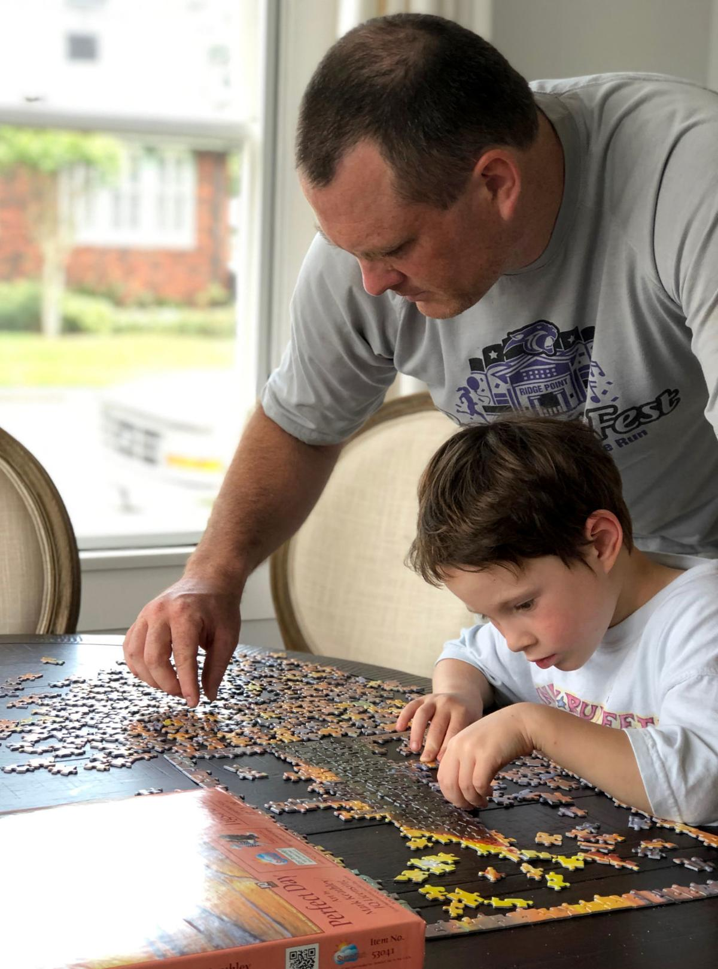
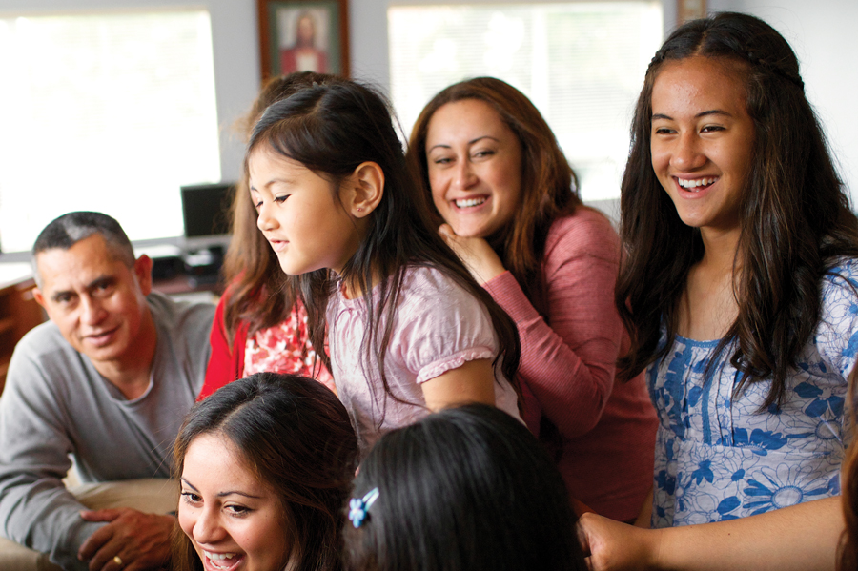
Curate a learning rich home atmosphere
Gathering
Tethering
Strewing
interesting books with visual appeal
games
puzzles
art supplies
tinker or building materials
nature items

Slide 19
Ask yourself:
How can you ensure that you’re building an authentic home atmosphere?
What would help you curate an environment that supports inquiry and invites your children to explore in satisfying ways?

Slide 20

11 Creative Ways to Spark Curiosity and Delight
Allow your child to define their identity.
Spread a wide feast.
Model interest in the world around you.
Emphasize the current topics of debate in a field.
Leverage technology to promote passion.
Diversify the voices speaking into your child.
Curate a learning-rich home atmosphere.
Keep your child supplied with tools of the trade and tolerate controlled messes.

Slide 21

Keep your child supplied with tools of the trade and tolerate controlled messes
Source materials and keep them on hand.
Respect the natural ebb and flow of self-directed work.
Ask them if you can set their work aside for awhile.

Slide 22

11 Creative Ways to Spark Curiosity and Delight
Allow your child to define their identity.
Spread a wide feast.
Model interest in the world around you.
Emphasize the current topics of debate in a field.
Leverage technology to promote passion.
Diversify the voices speaking into your child.
Curate a learning-rich home atmosphere.
Keep your child supplied with tools of the trade and tolerate controlled messes.
Set the pace.

Slide 23

Set the pace
Deep work involves slow learning.
Your child is creating meaning, understanding, and representations.
Creative work is nonlinear.
Creative work requires time and a relaxed mindset.

Slide 24

11 Creative Ways to Spark Curiosity and Delight
Allow your child to define their identity.
Spread a wide feast.
Model interest in the world around you.
Emphasize the current topics of debate in a field.
Leverage technology to promote passion.
Diversify the voices speaking into your child.
Curate a learning-rich home atmosphere.
Keep your child supplied with tools of the trade and tolerate controlled messes.
Set the pace.
Travel and visit new places

Slide 25

Travel and visit new places
Travel globally, if possible.
Commit to intentional community-minded living locally.
Connect your children to the world from the comfort of home:
Learn new languages.
Study the context in which people from various countries enjoy food and feasting.
Watch movies set in other countries.
Shop in specialty markets where you can encounter global foods, goods, and people.
Attend performances honoring the creative gifts of people whose paths you don’t usually cross.

Slide 26

11 Creative Ways to Spark Curiosity and Delight
Allow your child to define their identity.
Spread a wide feast.
Model interest in the world around you.
Emphasize the current topics of debate in a field.
Leverage technology to promote passion.
Diversify the voices speaking into your child.
Curate a learning-rich home atmosphere.
Keep your child supplied with tools of the trade and tolerate controlled messes.
Set the pace.
Travel and visit new places.
Become your child’s ally.

Slide 27

Become your child’s ally
Consistently show your child that you’re on their side.
Share in their joy.
Learn the lingo.
Be playful.
Help protect their margin.
Feed them well.

Slide 28
Ask yourself:
What does it mean to be my child’s ally?
What are some ways that parents can validate the legitimacy of their children’s passions?
What rhythms can you put in place to consistently make room for your child’s interests?

Slide 29
11 Creative Ways to Spark Curiosity and Delight
Allow your child to define their identity.
Spread a wide feast.
Model interest in the world around you.
Emphasize the current topics of debate in a field.
Leverage technology to promote passion.
Diversify the voices speaking into your child.
Curate a learning-rich home atmosphere.
Keep your child supplied with tools of the trade and tolerate controlled messes.
Set the pace.
Travel and visit new places.
Become your child’s ally.

Slide 30

Questions?
Website: HeritageMom.com
Instagram: @HeritageMomBlog
Facebook: /HeritageMomBlog

